Slide 1
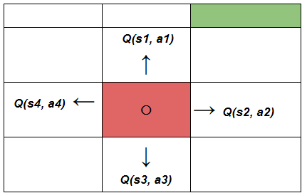
L7.2 Q-Learning
Zonghua Gu 2023
Acknowledgement: slides based on https://www.coursera.org/specializations/reinforcement-learning
And Hugging Face Deep RL Course https://huggingface.co/deep-rl-course
Notes:
https://blog.floydhub.com/an-introduction-to-q-learning-reinforcement-learning/

Slide 2
Outline
Introduction to RL
Q-Learning
Deep Q Learning w. Function Approximation

Slide 3
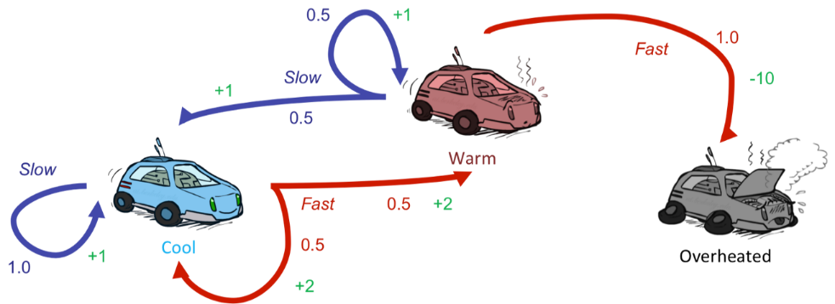
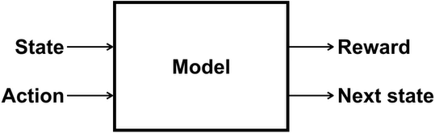

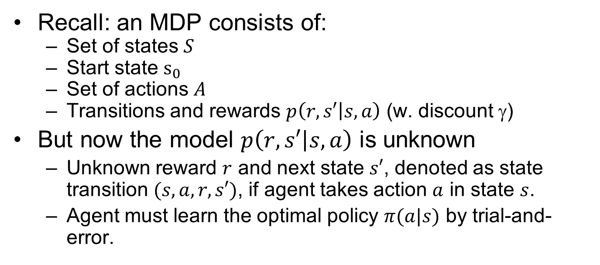
Reinforcement Learning
Recall: an MDP consists of:
Set of states $S$
Start state $s_{0}$
Set of actions $A$
Transitions and rewards $p\left(r,s′ | s,a\right)$ (w. discount $$)
But now the model $p\left(r,s′ | s,a\right)$ is unknown
Unknown reward $r$ and next state $s′$, denoted as state transition $(s,a,r,s′)$, if agent takes action $a$ in state $s$.
Agent must learn the optimal policy $π(a|s)$ by trial-and-error.
$$p\left(r,s′ | s,a\right)$$
Notes:
Still assume an MDP:
A set of states s ∈ S
A set of actions (per state) A
A model T(s,a,s’)
We The same $(s,a)$ may lead to different reward $r$ and next state $s′$, denoted as state transition $(s,a,r,s′)$,
I.e. we don’t know which states are good or what the actions do
A reward function R(s,a,s’)

Slide 4
Characteristics of RL
There is no supervisor, only a reward signal (may be sparse)
Feedback is delayed, not instantaneous
Sequential, non i.i.d (Independent and identically distributed) data
Agent's actions affect the subsequent data it receives
Notes:
What makes RL different from other ML paradigms?

Slide 5
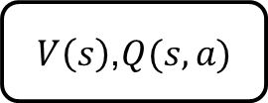

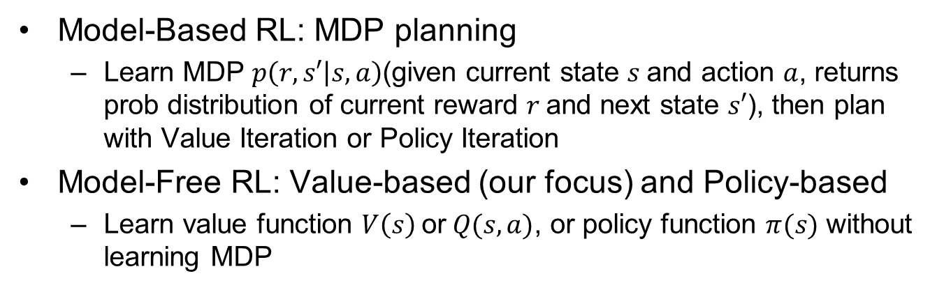


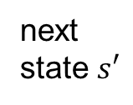
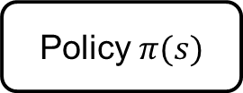

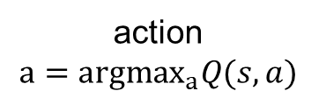




Model-Based vs. Model-Free
Model-Based RL: MDP planning
Learn MDP $p\left(r,s′ | s,a\right)$(given current state $s$and action $a$, returns prob distribution of current reward $r$and next state $s′$), then plan with Value Iteration or Policy Iteration
Model-Free RL: Value-based (our focus) and Policy-based
Learn value function $V\left(s\right)$ or$Q(s,a)$, or policy function $π(s)$ without learning MDP
state $s$
action $a$
state $s$
action $a$
state $s$
action $a$
MDP
$V\left(s\right)$,$Q(s,a)$
Policy $π(s)$
next
state $s′$
reward $r$
action
$$a={argmax}_{a}Q(s,a)$$
action $a=π(s)$
MDP-based RL | Value-based RL | Policy-based RL
Notes:
Model-based RL
Learn MDP model $p\left(r,s′ | s,a\right)$ then use Value Iteration or Policy Iteration to solve for the optimal value function and policy
Model-free (our focus)
Learn the optimal value function and/or policy directly without learning the MDP
Model-based
Learn MDP model $p\left(r,s′ | s,a\right)$, then solve for the optimal policy with PI or VI.
Model-free
Learn the optimal policy without learning MDP.
MPC is model-based; PID can be model-based or model-free $\left[s_{t+1},r_{t}\right]∼P(⋅|s_{t},a_{t};θ)$ $a_{t}=π(s_{t},θ)$ Estimate value $J(θ)$ and optimize it, without knowledge of model $P$Q-Learning/DQN, Policy Gradient, Imitation Learning… $θ$ denotes model params, e.g., edge weights in a DNN.

Slide 6
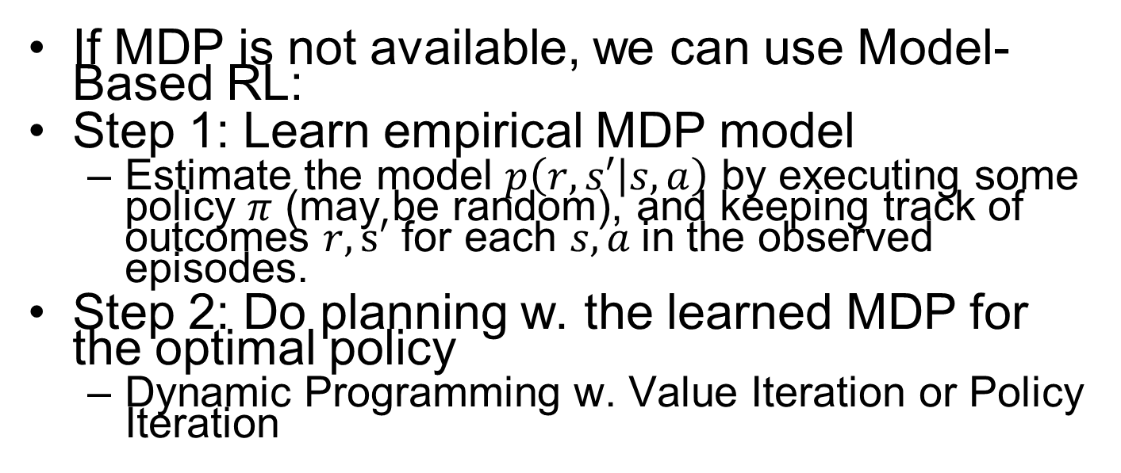
Model-Based RL
If MDP is not available, we can use Model-Based RL:
Step 1: Learn empirical MDP model
Estimate the model $p\left(r,s′ | s,a\right)$ by executing some policy $π$ (may be random), and keeping track of outcomes $r,s′$ for each $s, a$in the observed episodes.
Step 2: Do planning w. the learned MDP for the optimal policy
Dynamic Programming w. Value Iteration or Policy Iteration
Notes:
Learn an approximate MSP based on experiences, then solve the learned MDP
counting transitions out of each state
CH08: Planning and Learning
Normalize to estimate the probabilities $p\left(r,s′ | s,a\right)$

Slide 7
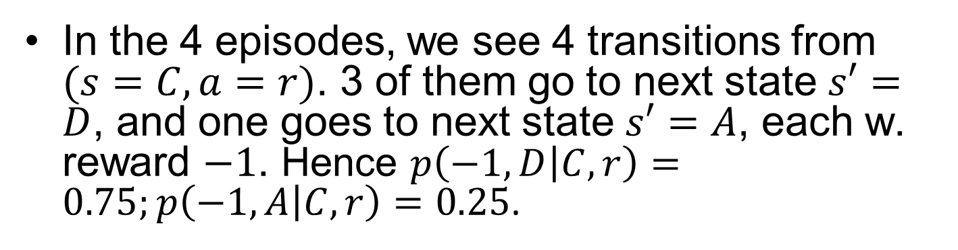
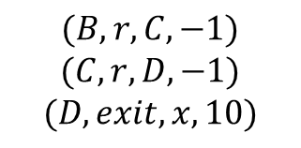


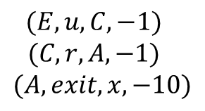
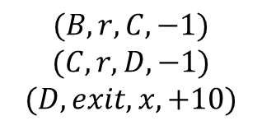

MiniGW: Model Learning
Input Policy π
Observed Episodes (Training)
Learned Model
Episode 1
Episode 2
$$p\left(r, s′ | s,a\right)$$
$$p\left(−1,C | B,r\right)=1.0$$
$$p\left(−1,D | C,r\right)=0.75$$
$$p\left(−1,A | C,r\right)=0.25$$
$$p\left(10,x | D,exit\right)=1.0$$
$$p\left(−10,x | A,exit\right)=1.0$$
 | A
B | C | D
 | E
$$(B, r, C, −1)$$
$$(C, r, D, −1)$$
$$(D, exit, x, 10)$$
$$(B, r, C, −1)$$
$$(C, r, D, −1)$$
$$(D, exit, x, +10)$$
Episode 3
Episode 4
$$(E, u, C, −1)$$
$$(C, r, D, −1)$$
$$(D, exit, x, 10)$$
$$(E, u, C, −1)$$
$$(C, r, A, −1)$$
$$(A, exit, x, −10)$$
Assume: γ = 1
In the 4 episodes, we see 4 transitions from $(s=C, a=r)$. 3 of them go to next state $s′=D$, and one goes to next state $s′=A$, each w. reward $−1$. Hence $p\left(−1,D | C,r\right)=0.75;p\left(−1,A | C,r\right)=0.25$.
Notes:
(may update $π$ and re-learn $\hat{T}(s,a,s’)$ iteratively)

Slide 8

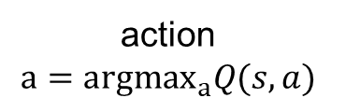




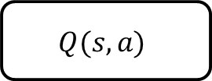



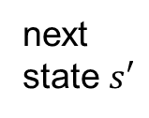
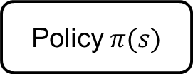
Value-based RL
state $s$
action $a$
state $s$
action $a$
state $s$
action $a$
MDP
$$Q(s,a)$$
Policy $π(s)$
next
state $s′$
reward $r$
action
$$a={argmax}_{a}Q(s,a)$$
action $a=π(s)$
MDP Planning | Value-based RL | Policy-based RL

Slide 9
Outline
Introduction to RL
Q-Learning
Deep Q Learning w. Function Approximation

Slide 10
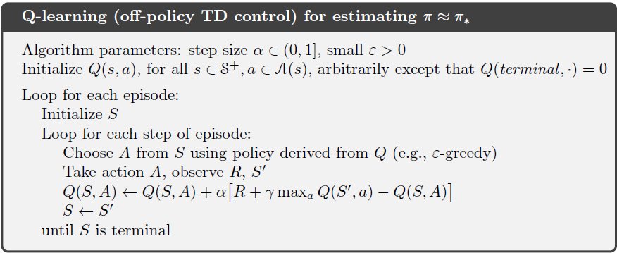
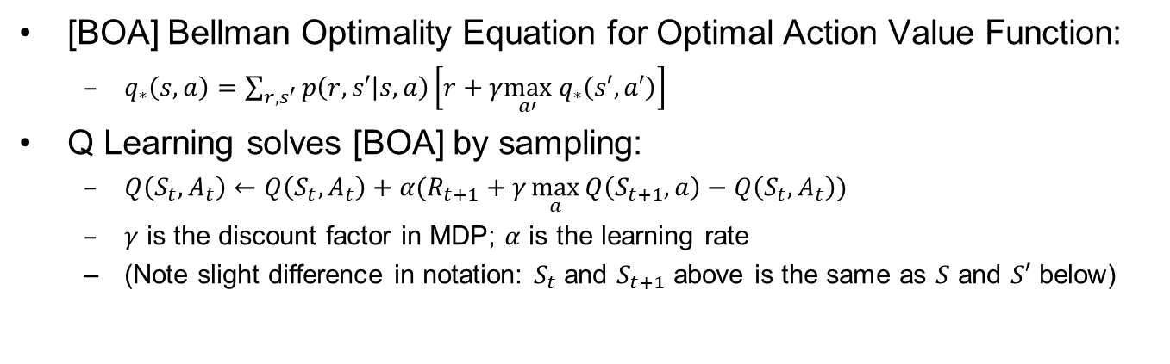
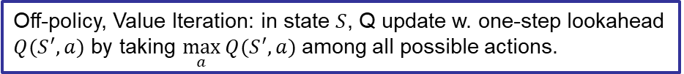
Q-Learning
[BOA] Bellman Optimality Equation for Optimal Action Value Function:
$q_{∗}\left(s,a\right)=\sum_{r,s^{′}}{p\left(r,s′ | s,a\right)}\left[r+γ\max_{a′} q_{∗}\left(s′,a′\right)\right]$
Q Learning solves [BOA] by sampling:
$Q\left(S_{t},A_{t}\right)←Q\left(S_{t},A_{t}\right)+α(R_{t+1}+γ\max_{a}{Q\left(S_{t+1},a\right)}−Q\left(S_{t},A_{t}\right))$
$γ$ is the discount factor in MDP; $α$ is the learning rate
(Note slight difference in notation: $S_{t}$ and $S_{t+1}$ above is the same as $S$ and $S′$ below)
Off-policy, Value Iteration: in state $S$, Q update w. one-step lookahead $Q(S^{′},a)$ by taking $\max_{a}{Q(S^{′},a)}$ among all possible actions.
Notes:
above: $a′$ is one possible action in the next state $S_{t+1}$; below: $a$ is one possible action in the next state $S′$)

Slide 11
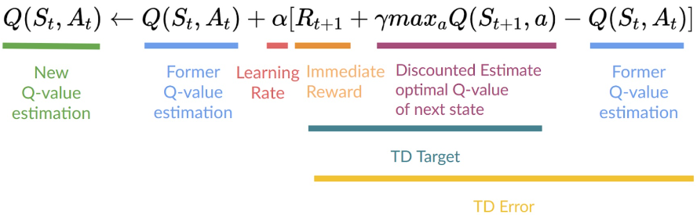
Q-Learning Update Equation

Slide 12
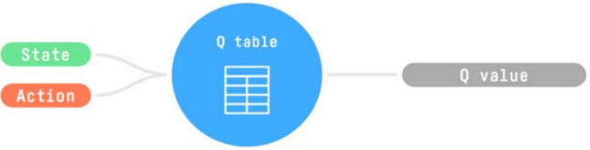

Q-Function
$Q\left(S,A\right)$ maps from state $S$and action $A$ to a Q value.
In Tabular QL, $Q\left(S,A\right)$is a Q-table, where each cell corresponds to a state-action value pair value.
In Deep QL, $Q\left(S,A\right)$is a Neural Network

Slide 13
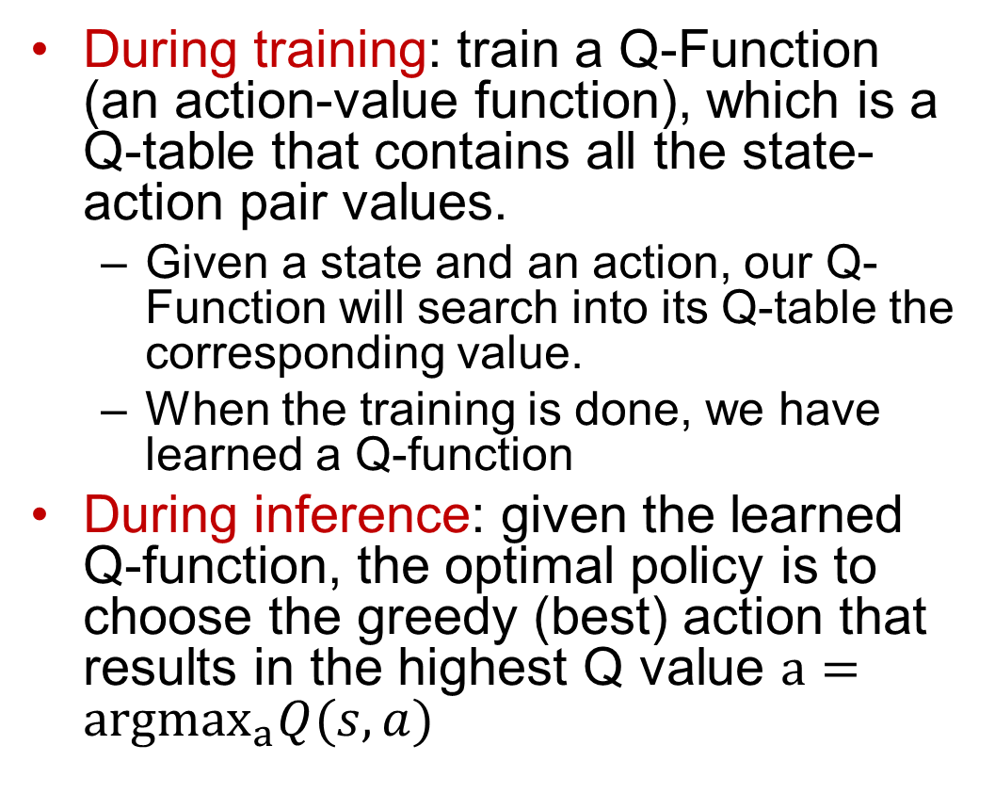
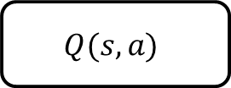
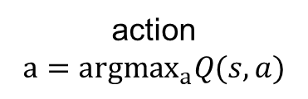
Q-Learning Steps
During training: train a Q-Function (an action-value function), which is a Q-table that contains all the state-action pair values.
Given a state and an action, our Q-Function will search into its Q-table the corresponding value.
When the training is done, we have learned a Q-function
During inference: given the learned Q-function, the optimal policy is to choose the greedy (best) action that results in the highest Q value $a={argmax}_{a}Q(s,a)$
state $s$
action $a$
$$Q(s,a)$$
action
$$a={argmax}_{a}Q(s,a)$$
Notes:
since we know for each state what is the best action to take.

Slide 14
Exploration-Exploitation Dilemma
The agent has to exploit what it has already experienced in order to obtain reward, but it also has to explore in order to make better action selections in the future
Exploitation: to obtain high reward, the agent prefers actions that it has tried in the past and proven to give high reward
Exploration: to discover such actions, it has to try actions that it has not selected before
Notes:
On a stochastic task, each action must be tried many times to gain a reliable estimate of its expected reward.
The dilemma is that neither exploration nor exploitation can be pursued exclusively without failing at the task. The agent must try a variety of actions and progressively favor those that appear to be best.

Slide 15
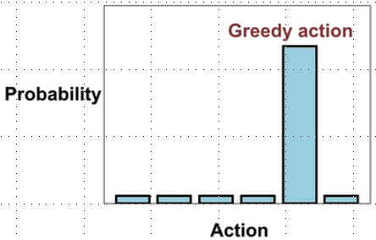
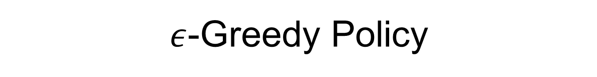
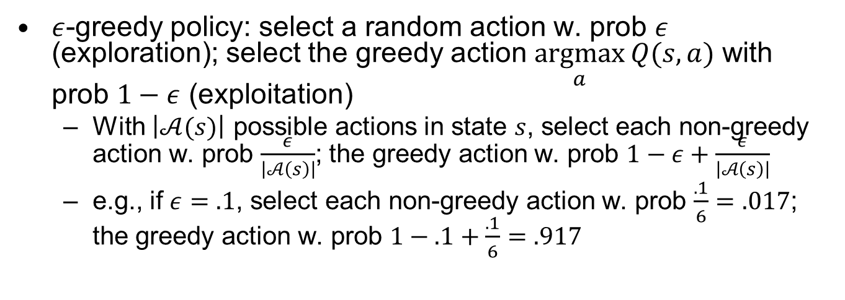
$ε$-Greedy Policy
$ε$-greedy policy: select a random action w. prob $ε$ (exploration); select the greedy action $\underset{a}{argmax}{Q(s,a)}$ with prob $1−ε$ (exploitation)
With $\left|𝒜(s)\right|$ possible actions in state $s$, select each non-greedy action w. prob $\frac{ε}{\left|𝒜\left(s\right)\right|}$; the greedy action w. prob $1−ε+\frac{ε}{\left|𝒜\left(s\right)\right|}$
e.g., if $ε=.1$, select each non-greedy action w. prob $\frac{.1}{6}=.017$; the greedy action w. prob $1−.1+\frac{.1}{6}=.917$
Notes:
1-.2+.2/5

Slide 16
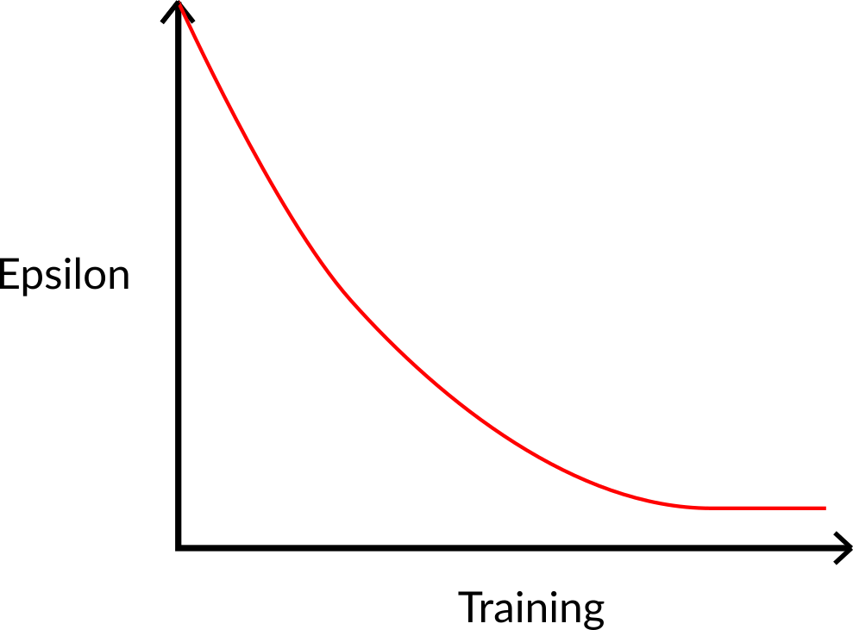
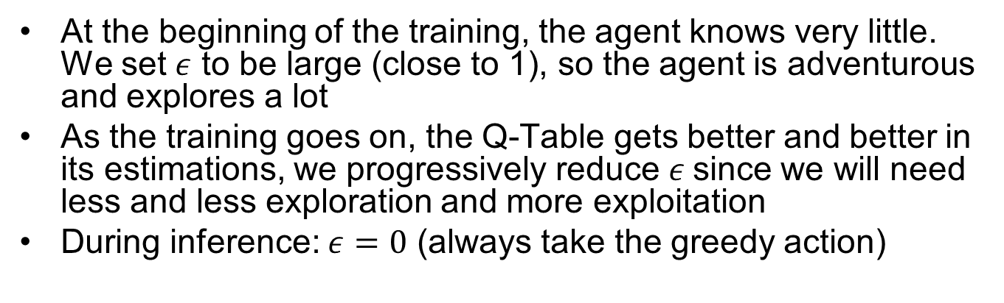
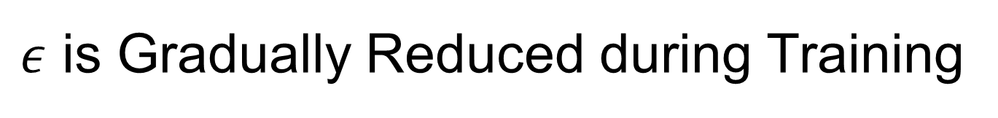
$ε$ is Gradually Reduced during Training
At the beginning of the training, the agent knows very little. We set $ε$ to be large (close to 1), so the agent is adventurous and explores a lot
As the training goes on, the Q-Table gets better and better in its estimations, we progressively reduce $ε$since we will need less and less exploration and more exploitation
During inference: $ε=0$ (always take the greedy action)

Slide 17
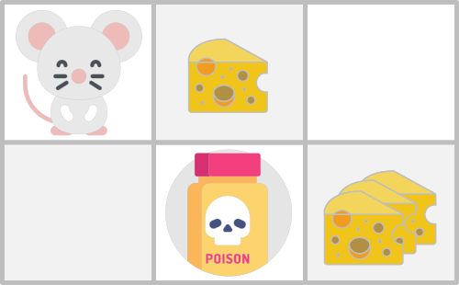
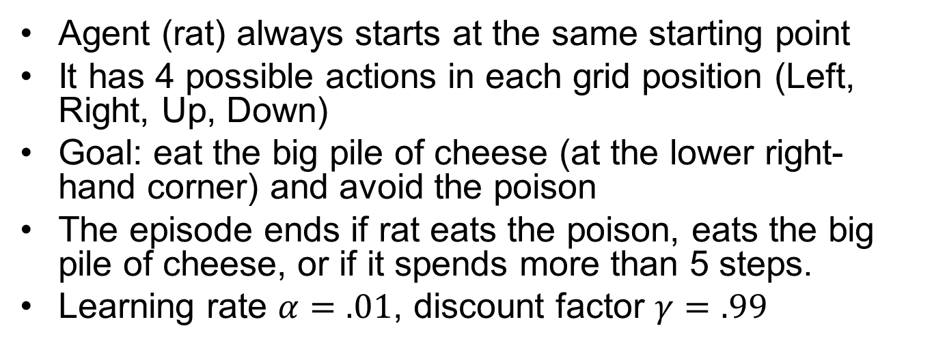
Example: a Maze
Agent (rat) always starts at the same starting point
It has 4 possible actions in each grid position (Left, Right, Up, Down)
Goal: eat the big pile of cheese (at the lower right-hand corner) and avoid the poison
The episode ends if rat eats the poison, eats the big pile of cheese, or if it spends more than 5 steps.
Learning rate $α=.01$, discount factor $γ=.99$

Slide 18
Reward Function
+0: Going to a state with no cheese in it.
+1: Going to a state with a small cheese in it.
+10: Going to the state with the big pile of cheese.
-10: Going to the state with the poison and thus die.
+0 If it spends more than five steps.

Slide 19
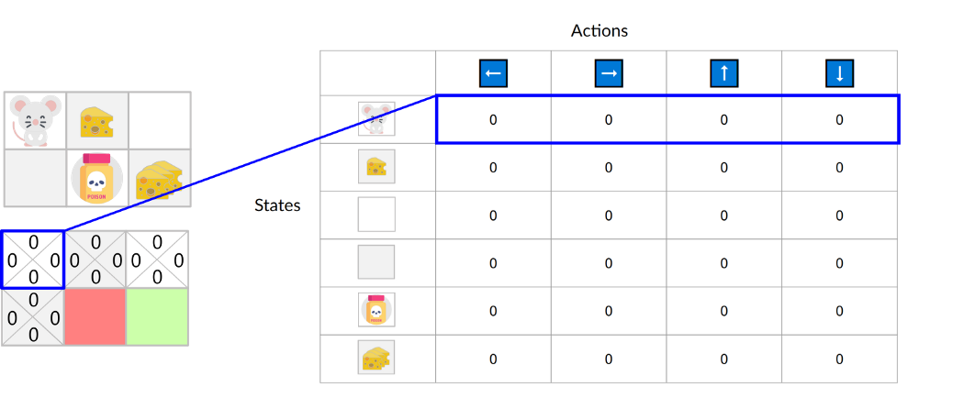

Initial Q-Table
All values are 0. This table contains, for each state, the four state-action values.
$Q\left(S,L\right),Q\left(S,R\right),Q\left(S,U\right),Q\left(S,D\right)$

Slide 20
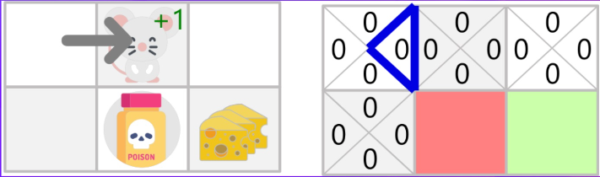
Step 1
Agent takes a random action, and moves right
It gets a small cheese with +1 reward

Slide 21
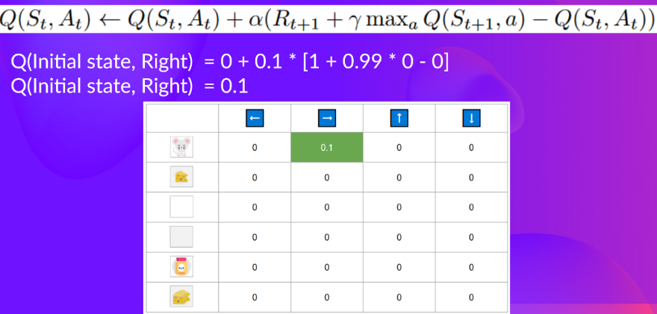

Q-Table Update
$Q\left(Init, Right\right)=0+.1\left(1+.99∗0−0\right)=.1$
Q-Learning

Slide 22
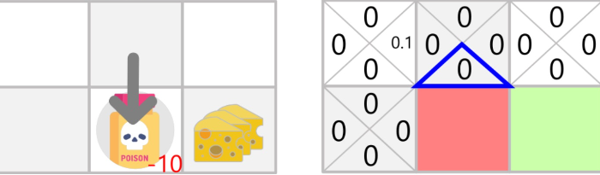
Step 2
Agent takes a random action, and moves down
It gets the poison with -10 reward
Episode ends

Slide 23
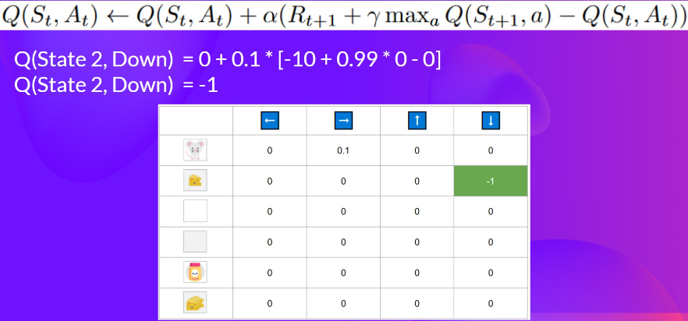
Q-Table Update

Slide 24
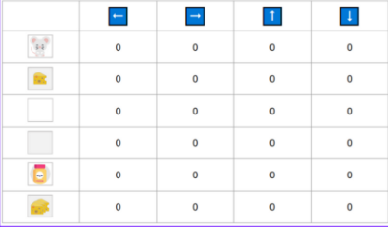
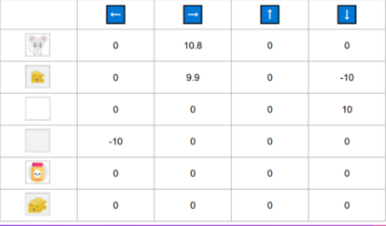
After Some Training Episodes
0
-10

Slide 25
Outline
Introduction to RL
Q-Learning
Deep Q Learning w. Function Approximation

Slide 26
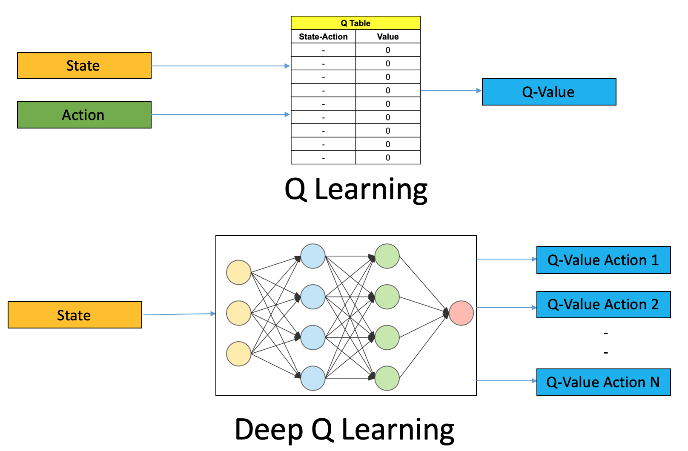
Q Learning vs. Deep QL
https://www.analyticsvidhya.com/blog/2019/04/introduction-deep-q-learning-python/

Slide 27
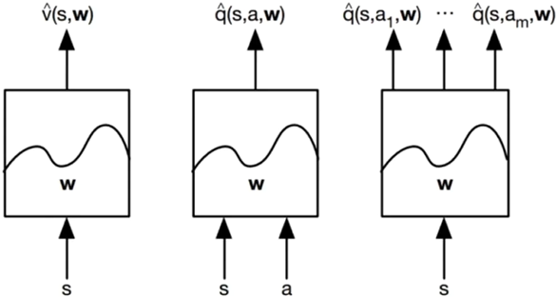
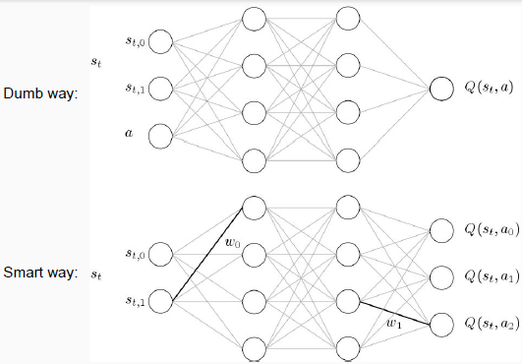
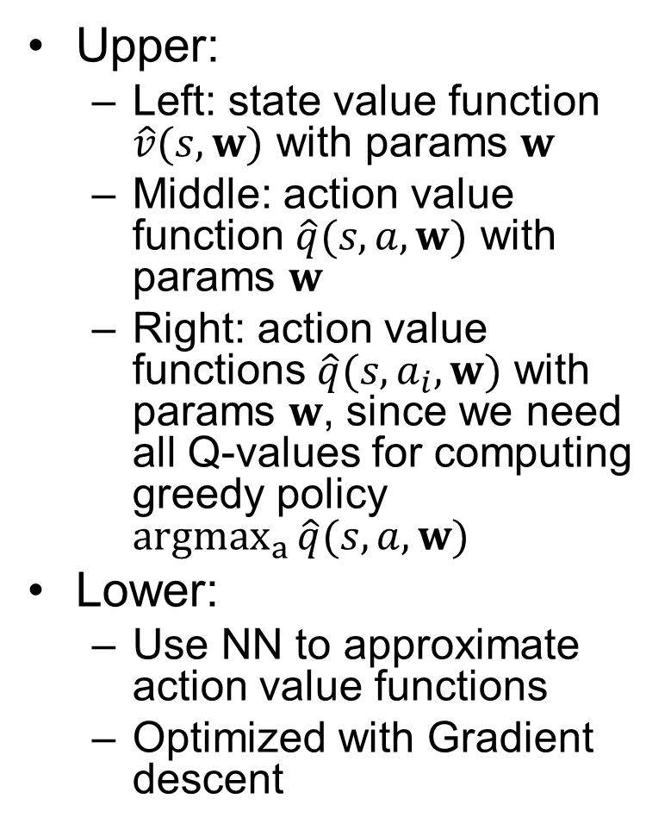
Function Approximations of Value Functions
Upper:
Left: state value function $\hat{v}(s,w)$ with params $w$
Middle: action value function $\hat{q}(s,a,w)$ with params $w$
Right: action value functions $\hat{q}(s,a_{i},w)$ with params $w$, since we need all Q-values for computing greedy policy ${argmax}_{a}{\hat{q}(s,a,w)}$
Lower:
Use NN to approximate action value functions
Optimized with Gradient descent
Notes:
(“Dumb way” corresponds to upper middle figure, and “Smart way” corresponds to upper right figure

Slide 28

Deep QL Pros and Cons
Pros:
Compresses Q-table with a Neural Network
Can handle states not seen during training
Cons
Deterministic: cannot learn stochastic policies
Cannot be directly applied to continuous action spaces (need to discretize)
Needs to separately add $ε$-greedy algorithm to balance exploration vs. exploitation.

Slide 29

DQN Extensions
Experience replay
Save transitions $(S_{t},A_{t},R_{t+1},S_{t+1})$ to buffer
Randomly sample from replay buffer and apply Q update
Target network
Use a separate Q-network to estimate TD-target
Target network is synced infrequently with main network
Reduce correlation between Q-value and TD-target
$Q\left(S_{t},A_{t}\right)←Q\left(S_{t},A_{t}\right)+α(R_{t+1}+γ\max_{a}{Q^{target}\left(S_{t+1},a\right)}−Q\left(S_{t},A_{t}\right))$
2) Deep Q Network DQN https://www.youtube.com/watch?v=By6TYFSIFVE

